Slide 1
2024 Final Budget & Levy Adoption
December 5th 2023

Slide 2
Public Input / Discussion
The Minnesota Department of Revenue provides the following guidance regarding tonight’s meeting:
Final Levy cannot exceed Preliminary Levy
State Statute 275.065 Subd. 6. - Adoption of budget and levy. (a) The property tax levy certified under section 275.07 by a city of any population, county, metropolitan special taxing district, regional library district, or school district must not exceed the proposed levy determined under subdivision 1
Discuss budget and proposed property tax
The proposed property tax levy for the taxes payable year 2024 and the proposed budget for the taxes payable year 2024, must be discussed at the public meeting.
Public comment and questions
The public must be given a reasonable amount of time to comment on the proposed property tax levy and budget and to ask questions. Robert’s Rules of Order may be used to govern the conduct of the meeting.

Slide 3
Fiscal Management
Manage Components of Municipal Budget
Consider Associated Timelines
Small & Steady Increases/Decreases in Levy/Tax Rate Over Time

Slide 4
Components of Municipal Budget
Category | Revenue | Expense | Competency
Operating Rev/Exp | GF Levy / Rates | 3-5 yr Avg., 6m Actual | All - Easy But Not Assured
Intergovernmental Rev/Exp | LGA / Grants | Regulations / Legislation | All - Legal Requirement
Capital Projects | Levy / Rates | 10-20 year Horizon | Most - $ to Engineer
Capital Maint./Replacement | Levy / Rates | 20 year Horizon | Few - Difficult **
** Largest Available Marginal Competitive Advantage

Slide 5
Property Tax Calculation
Why Tax Rate Is More Important Than Levy Amount
Levy Will Always Go Up Over Time
Tax Rate Provides Better Comparison Between Cities And Years
Tax Rate = Levy / Tax Capacity (Adjusted Market Value)
Property Value X Tax Rate = Property Taxes
Property owners can appeal the assessed value of their property at the annual Local (April) or County (June) Board of Equalization Meeting. Appeals affect the coming tax year, not current tax year.

Slide 6
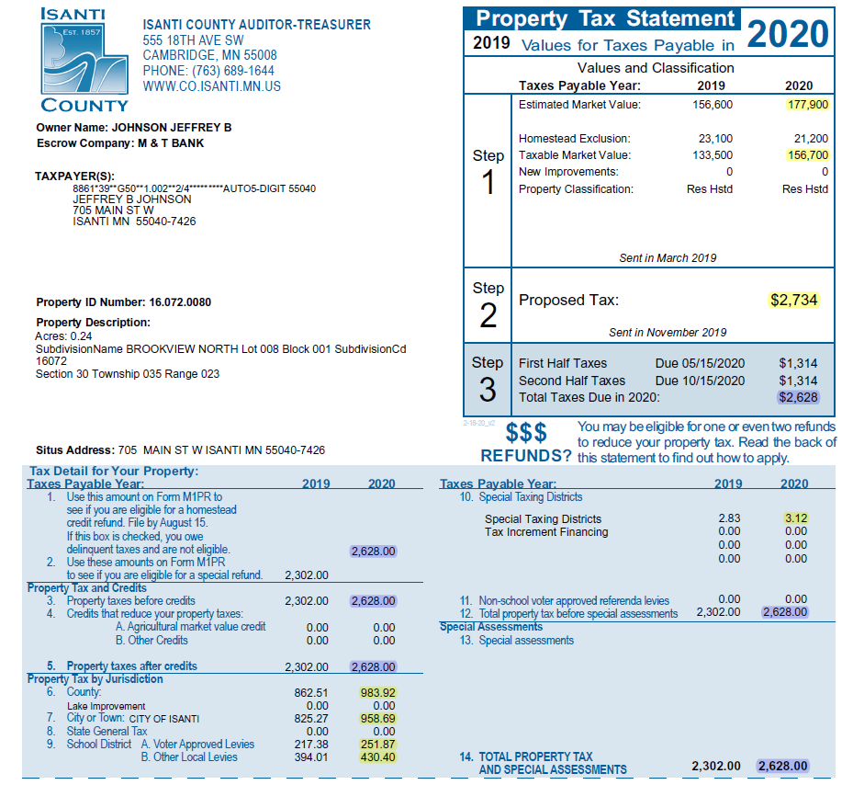
Value Determined by County Assessor, 90-105% of Fair Market Value by Statute
TMV=EMV Less Exclusions
Total Amount Originally Proposed
by Taxing Jurisdictions (September)
Total Amount After Final Adoption
By Taxing Jurisdictions (December)
10. East Central Regional
Development Commission
6. County Tax Amount
7. City Tax Amount
9.A/B. School District Tax Amount

Slide 7
Budget Options to Consider
Delaying Street Improvement Projects
  All current projects were originally identified in 2010
Delay / Eliminate Capital Maint/Replacement Items
  All items have been identified as needed
Reduce Operating Expenditures
  Contracts and other legal obligations may limit scope of possible changes

Slide 8
Budget Summary
Title / Detail | 2024 PROPOSED | 2023 BUDGET | 2022 BUDGET | 2022 ACTUAL | 2021 ACTUAL | 2020 ACTUAL
TAXES | 2,737,609 | 2,840,412 | 2,187,663 | 2,261,261 | 1,878,203 | 1,859,747
LICENSES/PERMITS | 237,050 | 260,525 | 388,500 | 316,775 | 351,751 | 448,614
INTERGOVERNMENTAL | 1,208,352 | 1,019,918 | 1,003,593 | 1,012,834 | 1,017,502 | 1,288,115
CHARGES FOR SERVICES | 164,750 | 165,425 | 199,400 | 255,146 | 179,380 | 129,488
FINES AND FORFEITURES | 28,500 | 35,800 | 38,850 | 22,821 | 33,284 | 32,756
MISCELLANEOUS | 44,500 | 37,850 | 51,400 | 17,614 | 25,662 | 68,470
TRANSFERS IN | 569,281 | 442,605 | 360,481 | 409,152 | 486,400 | 451,176
GENERAL FUND REVENUES | 4,990,042 | 4,802,535 | 4,274,890 | 4,295,603 | 3,972,182 | 4,278,366
COUNCIL | 39,780 | 44,550 | 40,064 | 37,155 | 35,679 | 40,038
ELECTIONS | 11,500 | - | 10,700 | 7,162 | 1,436 | 10,030
FINANCIAL ADMINISTRATION | 678,485 | 633,356 | 592,270 | 572,815 | 541,295 | 515,328
SPECIAL PROJECTS | - | - | - | - | 367 | 56,125
PLANNING AND ZONING | 144,900 | 167,875 | 160,478 | 147,696 | 138,485 | 133,373
MUNICIPAL BUILDING | 53,740 | 50,835 | 38,140 | 52,422 | 49,593 | 38,153
POLICE ADMINISTRATION | 2,169,580 | 2,021,860 | 1,863,451 | 1,734,545 | 1,683,863 | 1,411,553
FIRE PROTECTION | 331,900 | 304,300 | 273,600 | 276,030 | 253,972 | 244,229
BUILDING INSPECTION ADMIN | 243,760 | 295,890 | 278,382 | 262,555 | 223,386 | 398,040
CODE ENFORCEMENT | - | - | - | - | 11,369 | 11,393
CIVIL DEFENSE | 2,220 | 2,470 | 2,140 | 2,140 | 2,140 | 2,140
ANIMAL CONTROL | 1,360 | 3,110 | 3,095 | 1,122 | 3,000 | 3,071
GENERAL CITY MAINTENANCE | 70,735 | 68,080 | 60,995 | 61,004 | 53,649 | 45,824
HWYS, STREETS, & ROADS | 470,060 | 461,360 | 424,054 | 395,840 | 329,138 | 344,865
STREET LIGHTING | 56,980 | 56,100 | 53,500 | 53,768 | 58,434 | 53,811
SANITATION ADMINISTRATION | 33,640 | 31,800 | 26,450 | 24,514 | 23,633 | 23,023
PARK,REC,CULTURE | 429,185 | 453,485 | 406,920 | 380,724 | 338,477 | 333,074
TRANSFERS | 33,265 | 50,825 | 25,765 | - | - | -
MISCELLANEOUS | 16,510 | 15,460 | 14,885 | 42,161 | 14,986 | 363,183
GENERAL FUND EXPENDITURES | 4,787,600 | 4,661,356 | 4,274,889 | 4,051,653 | 3,762,902 | 4,027,252
NET INCOME / (LOSS) | 202,442 | 141,179 | 1 | 243,949 | 209,280 | 251,114

Slide 9
Budget Summary
Title / Detail | 2024 PROPOSED | 2023 BUDGET | 2022 BUDGET | 2022 ACTUAL | 2021 ACTUAL | 2020 ACTUAL
EDA REVENUES | 150,591 | 134,175 | 111,448 | 113,583 | 105,402 | 101,322
EDA EXPENDITURES | 142,661 | 134,175 | 109,351 | 105,738 | 228,985 | 108,227
NET INCOME / (LOSS) | 7,930 | - | 2,097 | 7,846 | (123,583) | (6,905)
STREET CONSTRUCTION REVENUES | 597,790 | 707,100 | 402,150 | 579,311 | 542,416 | 163,092
STREET CONSTRUCTION EXPENDITURES | 10,300 | 400,000 | 657,000 | 544,418 | 753,022 | 675,253
NET INCOME / (LOSS) | 587,490 | 307,100 | (254,850) | 34,893 | (210,606) | (512,162)
PAVEMENT MANAGEMENT REVENUES | 357,255 | 342,495 | 336,269 | 324,906 | 332,803 | 319,735
PAVEMENT MANAGEMENT EXPENDITURES | 235,520 | 285,825 | 323,750 | 402,627 | 294,998 | 292,477
NET INCOME / (LOSS) | 121,735 | 56,670 | 12,519 | (77,722) | 37,805 | 27,258
WATER FUND REVENUES | 1,765,550 | 1,675,500 | 1,765,464 | 1,867,242 | 1,758,946 | 2,227,497
WATER FUND EXPENDITURES | 1,761,975 | 2,733,126 | 2,186,820 | 1,140,512 | 1,084,429 | 1,003,294
NET INCOME / (LOSS) | 3,575 | (1,057,626) | (421,356) | 726,730 | 674,516 | 1,224,203
NET CASH FLOW / (LOSS) | 433,575 | (637,626) | (16,356) | 1,154,079 | 1,099,785 | 1,631,539
SEWER FUND REVENUES | 1,881,500 | 1,740,000 | 2,040,159 | 1,869,097 | 1,885,243 | 2,467,919
SEWER FUND EXPENDITURES | 2,163,409 | 2,002,844 | 2,296,896 | 1,593,377 | 1,472,253 | 1,398,612
NET INCOME / (LOSS) | (281,909) | (262,844) | (256,737) | 275,721 | 412,990 | 1,069,307
NET CASH FLOW / (LOSS) | 356,073 | 331,138 | 312,245 | 882,670 | 1,003,562 | 1,640,332
STORM WATER FUND REVENUES | 286,525 | 310,300 | 404,800 | 312,872 | 392,528 | 375,320
STORM WATER FUND EXPENDITURES | 271,021 | 251,091 | 213,668 | 178,062 | 210,842 | 154,339
NET INCOME / (LOSS) | 15,504 | 59,209 | 191,132 | 134,810 | 181,686 | 220,980
NET CASH FLOW / (LOSS) | 96,504 | 134,209 | 261,132 | 207,679 | 241,108 | 276,837
MUNICIPAL LIQUOR FUND REVENUES | 5,859,915 | 5,143,265 | 4,386,054 | 5,226,002 | 4,558,160 | 3,985,132
MUNICIPAL LIQUOR FUND EXPENDITURES | 5,879,815 | 5,226,210 | 4,405,728 | 4,900,821 | 4,550,405 | 3,808,655
NET INCOME / (LOSS) | (19,900) | (82,945) | (19,674) | 325,182 | 7,756 | 176,477
NET CASH FLOW / (LOSS) | 67,600 | (7,945) | 326 | 362,166 | 15,061 | 201,060
CITY TECHNOLOGY REVENUES | 23,650 | 27,000 | 28,190 | 24,942 | 26,370 | 26,264
CITY TECHNOLOGY EXPENDITURES | 8,000 | 20,473 | 27,779 | 46,394 | 24,375 | 23,122
NET INCOME / (LOSS) | 15,650 | 6,527 | 411 | (21,452) | 1,995 | 3,143
CAPITAL IMPROVEMENT REVENUES | 750,502 | 773,962 | 700,056 | 655,934 | 848,233 | 286,436
CAPITAL IMPROVEMENT EXPENDITURES | 885,791 | 799,608 | 486,520 | 204,349 | 1,937,321 | 281,370
NET INCOME / (LOSS) | (135,289) | (25,646) | 213,536 | 451,585 | (1,089,087) | 5,066

Slide 10
Fiscal Management
Small & Steady Increases/Decreases in Levy/Tax Rate Over Time
Manage Components of Municipal Budget
  Operating Rev/Exp
    Staffing, PRC Programming, Road Maint., Snow Removal, Police Presence/Patrols, Fire Protection
    Capital Projects
      Identify and fund on consistent annual basis. Expenditures will vary annually but revenue collection should be consistent and predictable
      2028 is scheduled for 1.37 million in expenses. 2028 levy for street projects expected to be 373k.
      Avoid issuing bonds (debt) whenever possible. Borrowing 1 million costs roughly 250k in interest and issuance costs, at the lowest historical Muni rates. Currently the cost is closer to 350k.
      Capital Maintenance/Replacement
        Identify and fund on consistent annual basis. Expenditures will vary annually but revenue collection should be consistent and predictable
        2024 is scheduled for 885k in expenses. 2024 levy for Capital Maint/Replacement is expected to be 360k
        20-year plan should include ALL maintenance and replacement items. From squad cars and plow trucks to tuck pointing brickwork.
        Review annually and only replace when needed. If equipment performs beyond expected useful life, move scheduled expense to following year and reevaluate.

Slide 11
Considerations in Setting Levy
Capital Project Funding
  Next 6 years of street projects identified in 2010 to begin in 2012
  Capital Maintenance/Replacement Funding
    20-year cash flow analysis is presented, 35-40 years is monitored.
    Fund Balance – General Fund
      26k annual repayment to Liquor Fund for 2018 Improvements, 10 year repayment ends in 2029 budget year

Slide 12
Proposed Levy
LEVY | 2024 | 2023 | CHANGE FROM PRIOR
GENERAL FUND LEVY (101) | $ 2,704,784 | $ 2,805,000 | -3.57% | $ (100,216)
CAPITAL MAINT. LEVY (920) | $ 360,000 | $ 177,500 | 102.82% | $ 182,500
STREET CONST. LEVY (425) | $ 319,000 | $ 307,000 | 3.91% | $ 12,000
EDA LEVY (108) | $ 137,491 | $ 122,375 | 12.35% | $ 15,116
ABATEMENT LEVY (101) | $ 13,925 | $ 14,112 | -1.32% | $ (187)
DEBT SERVICE LEVY | $ 201,705 | $ 258,967 | -22.11% | $ (57,262)
TOTAL LEVY | $ 3,736,905 | $ 3,684,954 | 1.41% | $ 51,951

Slide 13
Levy History

Slide 14
Levy or Tax Rate?

Slide 15
ACTUAL 2022 DATA
CITY A | CITY B
152K LEVY | 8.6M LEVY

Slide 16
ACTUAL 2022 DATA
CITY A | CITY B
152K LEVY | 8.6M LEVY
297.8% TAX RATE | 34.5% TAX RATE

Slide 17
ACTUAL 2022 DATA
CITY A | CITY B
152K LEVY | 8.6M LEVY
297.8% TAX RATE | 34.5% TAX RATE
79K MARKET VALUE | 350K MARKET VALUE

Slide 18
ACTUAL 2022 DATA
CITY A | CITY B
152K LEVY | 8.6M LEVY
297.8% TAX RATE | 34.5% TAX RATE
79K MARKET VALUE | 350K MARKET VALUE

Slide 19
ACTUAL 2022 DATA
CITY A | CITY B
152K LEVY | 8.6M LEVY
297.8% TAX RATE | 34.5% TAX RATE
79K MARKET VALUE | 350K MARKET VALUE
 | 2022 CITY TAX $1,193

Slide 20
ACTUAL 2022 DATA
CITY A | CITY B
152K LEVY | 8.6M LEVY
297.8% TAX RATE | 34.5% TAX RATE
79K MARKET VALUE | 350K MARKET VALUE
2022 CITY TAX $1,465 | 2022 CITY TAX $1,193

Slide 21
Proposed Tax Rate
 | 2024 | 2023 | CHANGE FROM PRIOR
TAX RATE | 47.957% | 52.682% | -8.97%
AVG. TAX RATE - 2009-2023 | 66.222%
% ABOVE (+) / BELOW (-) AVG. | -27.58%

Slide 22
Tax Rate History

Slide 23
Levy / Tax Rate History

Slide 24
Competitive Metric
 | TAX RATES
CITY | 2017 | 2018 | 2019 | 2020 | 2021 | 2022 | 2023 | NET CHANGE |  | 2024 PRELIM | NET CHANGE
OTSEGO | 37.852 | 36.556 | 36.060 | 35.099 | 34.653 | 34.545 | 29.571 | -21.88%
EAST BETHEL | 47.222 | 44.510 | 43.204 | 41.467 | 38.348 | 37.391 | 31.761 | -32.74% |  | 31.500 | -33.29%
LINO LAKES | 45.140 | 42.825 | 41.816 | 39.869 | 40.109 | 40.154 | 34.974 | -22.52% |  | 36.080 | -20.07%
ZIMMERMAN | 47.469 | 45.656 | 44.578 | 41.239 | 41.624 | 42.697 | 36.812 | -22.45%
NORTH BRANCH | 55.069 | 52.982 | 49.466 | 47.411 | 45.072 | 44.097 | 37.685 | -31.57% |  | 41.000 | -25.55%
ELK RIVER | 46.193 | 46.011 | 45.907 | 46.241 | 44.556 | 43.967 | 39.700 | -14.06%
RAMSEY | 42.454 | 41.727 | 40.353 | 39.592 | 39.251 | 42.239 | 40.429 | -4.77% |  | 41.170 | -3.02%
ST. FRANCIS | 54.117 | 53.996 | 53.175 | 50.542 | 50.589 | 51.147 | 44.719 | -17.37% |  | 49.990 | -7.63%
ISANTI | 85.933 | 79.599 | 61.818 | 61.180 | 60.399 | 59.012 | 52.682 | -38.69% |  | 47.957 | -44.19%
PRINCETON | 73.901 | 71.907 | 69.782 | 66.565 | 61.617 | 63.980 | 54.783 | -25.87%
CAMBRIDGE | 85.693 | 81.252 | 76.653 | 75.052 | 73.203 | 70.182 | 63.226 | -26.22% |  | 59.500 | -30.57%
BRAHAM | 88.267 | 84.841 | 84.391 | 76.354 | 77.329 | 79.722 | 114.758 | 30.01%

